Slide 1
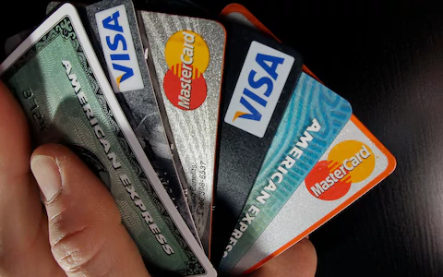
Credit Card Default
By: Anthony Schams & Ngoc Tran
August 16, 2019

Slide 2
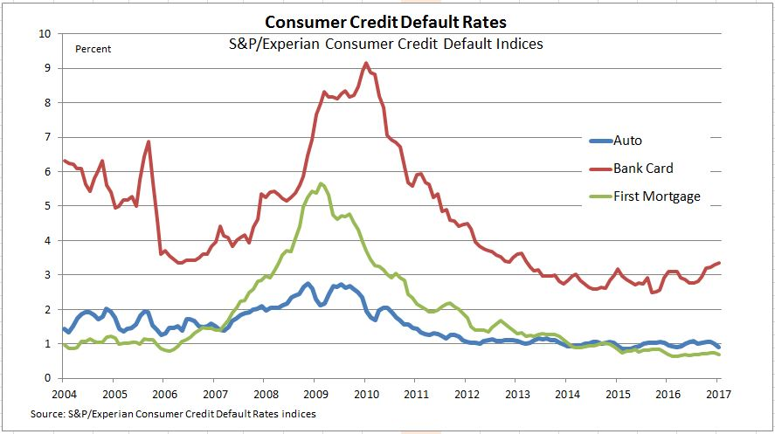
Introduction
Goal:
Predicting who is about to default on his/her credit card
Data:
UCI Machine Learning Repository
Number of Instances: 30,000
Number of Attributes: 24
Predictors:
credit limit
basic personal info
past payments and bill statements info
Target Variable:
default payment next month
Notes:
Credit card default can be a big concern for banks. Historically speaking, credit card default rate has been higher than auto loan default rate AND first mortgage default rate.
Consumers defaulting on their credit cards can cost banks a lot of money.
We are interested in helping banks predict who is about to default on his or her credit card.
The data set we used is from UCI ML Repository. It has 30,000 rows and 24 columns. The predictors are ….. and the target variable is ….

Slide 3
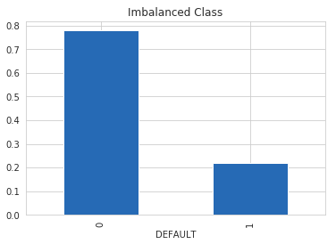
Processed Data
Convert all categorical variables into dummy variables.
Transform all numerical features using Yeo-Johnson transformation.
Scale all numerical features using Min-Max scaler.
Final datasets:
As-is
Over-sampled
Under-sampled
SMOTE
Notes:
Since our numerical features have lots of outliers, contain negative values, and are not normally distributed, we transform them using Yeo-Johnson transformation.
We then scale them using Min-Max scaler to get values between 0 and 1.

Slide 4
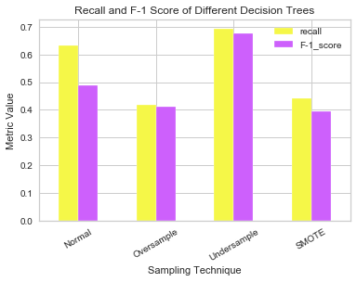
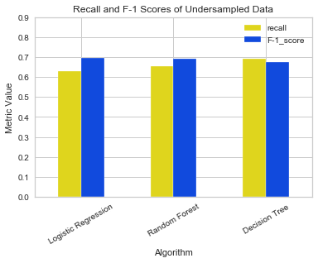
Models Comparison
Notes:
Talk about why recall…. Based on our business goal

Slide 5
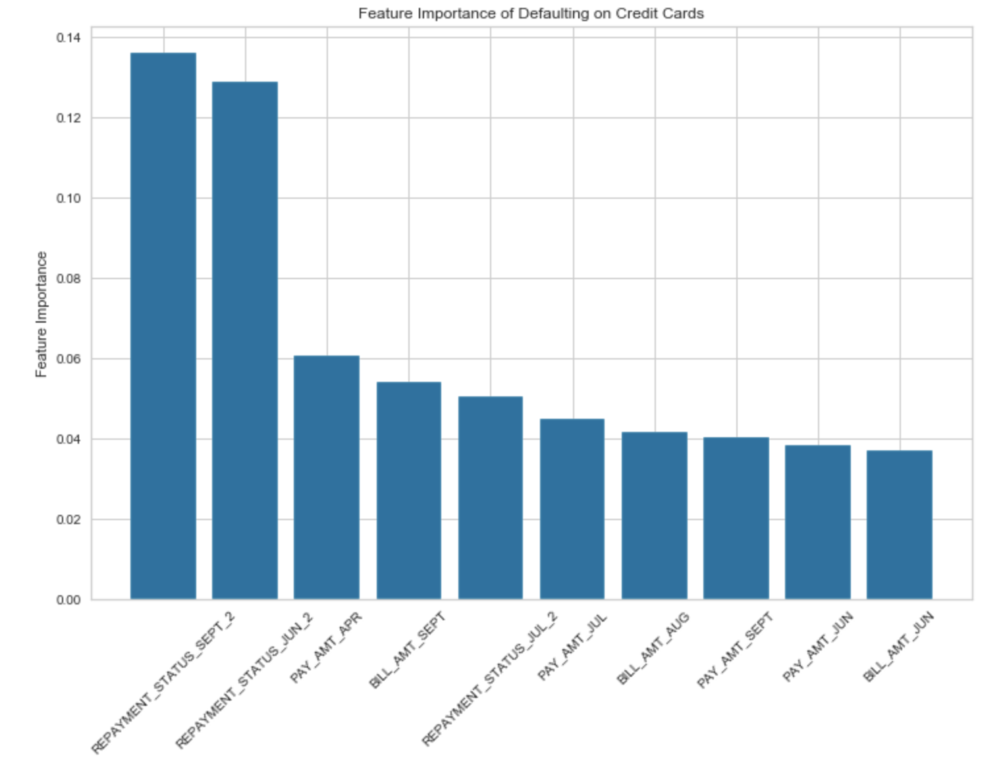
Best Model
Model:
Decision Tree
Data:
Under-sampled

Slide 6
Conclusions
Decision Tree on undersampled data yielded the best model, according to recall
Being 2 months late on payments is a strong signal that a customer will default
Bill amount also associated with default prediction

Slide 7
Next Steps for Future Improvements
Collect more (and relevant) features (IS_EMPLOYED, SALARY, etc.)
Collect more data
Try more Machine Learning algorithms
Try Anomaly Detection algorithms

Slide 8
Questions?

Slide 9
THANK YOU!

Slide 10
Sources
https://archive.ics.uci.edu/ml/datasets/default+of+credit+card+clients
https://scikit-learn.org/stable/modules/generated/sklearn.preprocessing.PowerTransformer.html
https://scikit-learn.org/stable/modules/generated/sklearn.preprocessing.MinMaxScaler.html
https://machinelearningmastery.com/tactics-to-combat-imbalanced-classes-in-your-machine-learning-dataset/
https://scikit-learn.org/stable/modules/generated/sklearn.linear_model.LogisticRegression.html
https://scikit-learn.org/stable/modules/generated/sklearn.tree.DecisionTreeClassifier.html
https://scikit-learn.org/stable/modules/generated/sklearn.ensemble.RandomForestClassifier.html

